Slide 1
Issue Discussion
2020/01/10
Jerry Chang

Slide 2
Outline
Execution flow for csim_ASIC
Issue Discussion
  Function execution at specified address (CBDMA_SRAM)

Slide 3
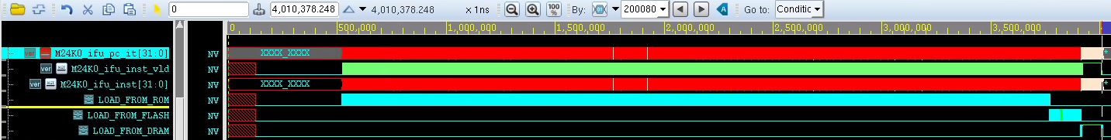
Execution flow for csim_ASIC
Execution Steps
ROM → SPI_FLASH → DRAM
(0xbfc0xxxx) (0x9800xxxx or 0xb800xxxx) (0x8100xxxx)
Q1. How to move the code to DRAM?
Q2. Why CPU start to fetches code from DRAM, not FLASH?
Ans: MMU may changed, 0x81000000 (need to trace code)

Slide 4
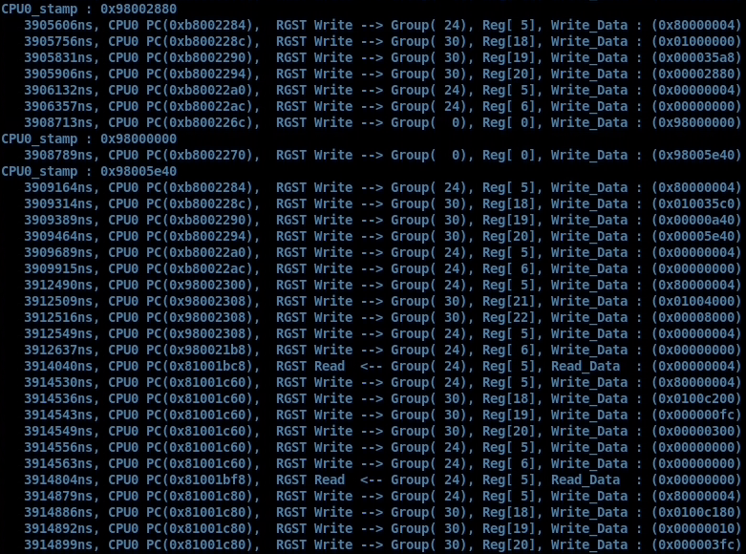
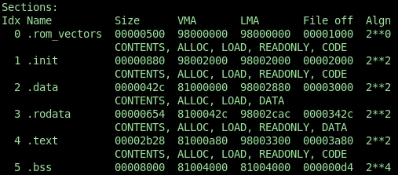
Q1. How to move the code to DRAM?
Move .data, .rodata,.text to 0x81000000
Size: 0x35A8= 0x42C+0x654+0x2B28
Move .bss to 0x81004000
Size: 0x8000
Ans: It copies code using DDR_SETTER

Slide 5
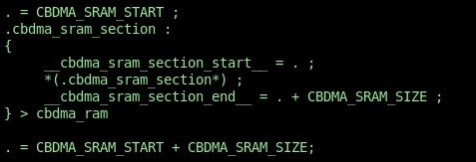
Issue Discussion
– Function execution at CBDMA SRAM address
Solutions 1→ FAIL
  Change SECTION from Linking Script in ASIC_CSIM
  0xbffc000 is too far from ENTRY (0x81000000), GCC reports “ relocation truncated,” I guess it not allow to build such a huge binary file (try to use –mcmodel=large)
  ( Approximated size 0xbffc0000- 0x81000000 ~= 1GB)
  .ld file
  .h file

Slide 6
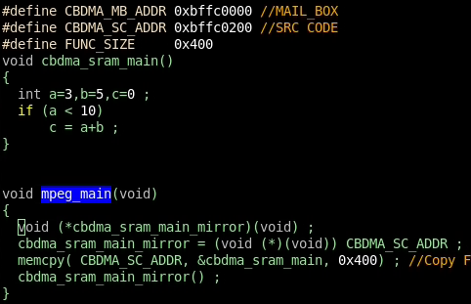
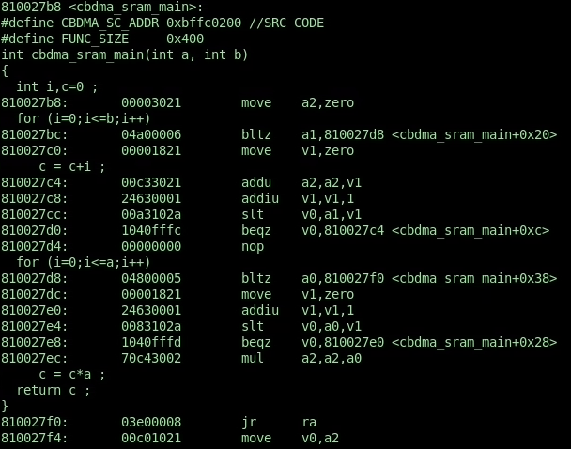
Issue Discussion
– Function execution at CBDMA SRAM address
Solutions 2 → FAIL
  Simple Function pointer + memcpy
    It can not allow to use the branch instructions because the jump address is absolute address

Slide 7
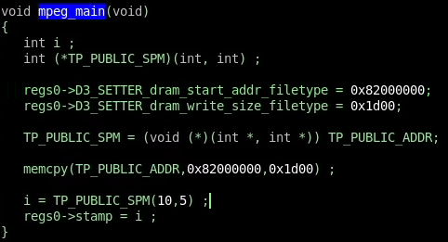
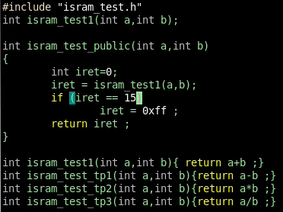
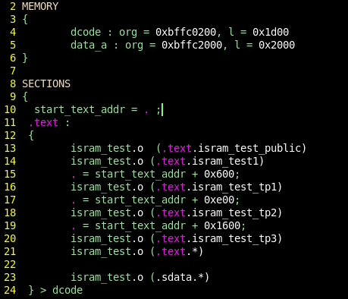
Solutions 3 (Success)
Function pointer + independent compilation with different linking
Main (testcase)
Subject function

Slide 8
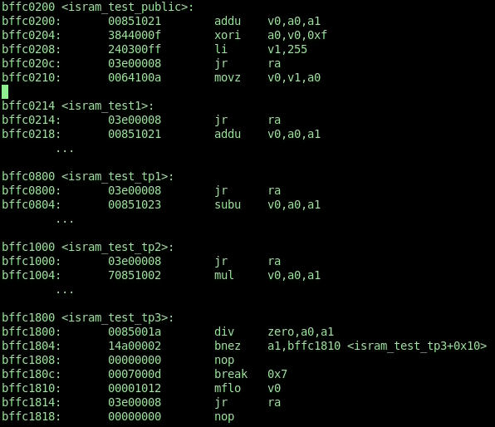

Slide 9
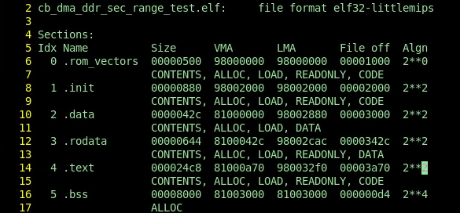
Appendix
  .dis file (follows ELF format)
.init : Executing code before instruction
.data: Initialized data, e.g., int a = 5 ;
.rodata: Constant data, e.g., const int 5 ; (RO)
.text : Instruction
.bss: Uninitialized data, e.g.,
  VMA(Virtual Memory Address) : CPU View
  LMA(Load Memory Address : Real system address mapping
Following this setting,
0x81000000 should maps to 0x98000000
In csim_ASIC, 0x81000000 maps to 0x81000000
cause by MMU setting (need to clarify)
References:
https://blog.gtwang.org/programming/memory-layout-of-c-program/
https://www.crifan.com/detailed_lma_load_memory_address_and_vma_virtual_memory_address/
http://sp1.wikidot.com/elfobjfile

